Slide 1
Finance Management System
GROUP MEMBERS
S.No. | Enrollment # | Student Name
1 | 02-131222-083 | Syed Fahad Ali Gillani

Slide 2
Table of Contents
Introduction
Background
Problem Statement
Proposed Solution
Project Scope
Working Software Demo
References

Slide 3
Introduction
In today's world, managing money can be tricky with so many things to keep track of. That's why we're working on a Financial Management System (FMS) project. The FMS is like a digital helper that makes it easier for people and businesses to handle their money smartly. It does things like keeping tabs on where money is going, setting budgets, reaching savings goals, and showing how well everything is going financially. Our project idea came from seeing how complex money matters can be nowadays and the need for tools that anyone can use to manage money better.

Slide 4
Background
The Financial Management System (FMS) project addresses the intricate challenges individuals and businesses face in managing finances today. With a comprehensive suite of tools, including expense tracking, budget setting, and savings goal monitoring, the FMS streamlines financial management processes. By leveraging advanced data analysis, it empowers users to make informed decisions and foster proactive financial planning. Ultimately, the FMS aims to promote greater financial literacy and well-being through its user-centric design and robust functionality.

Slide 5
Problem Statement
In today's dynamic financial environment, individuals and organizations struggle to manage finances effectively due to complexity and lack of automation. Traditional methods fall short in organizing and tracking income, expenses, and investments, leading to a need for a user-friendly Financial Management System. This system should centralize data, offer real-time insights, and enable informed decision-making to improve financial health and achieve goals.

Slide 6
Proposed Solution
The proposed solution offers a comprehensive array of features designed to streamline financial management. Users can securely authenticate and access the platform, which provides tools for tracking income and expenses, managing budgets, and setting and monitoring financial goals. Reminders and notifications keep users on track, while detailed management capabilities cover income sources, expense frequencies, and recurring expenses. Additionally, users can efficiently manage payment methods, track savings goal progress, and oversee debt, investment, and asset portfolios. Overall, the solution empowers users to take control of their finances with ease and confidence.

Slide 7
Features In Proposed Solution
User Authentication
Income and Expense Tracking
Budget Management
Goal Setting and Tracking
Reminders and Notifications
Income Source Management
Expense Frequency Management
Recurring Expenses Management
Payment Method Management
Savings Goal Progress Tracking
Debt Management
Investment Management
Asset Management

Slide 8
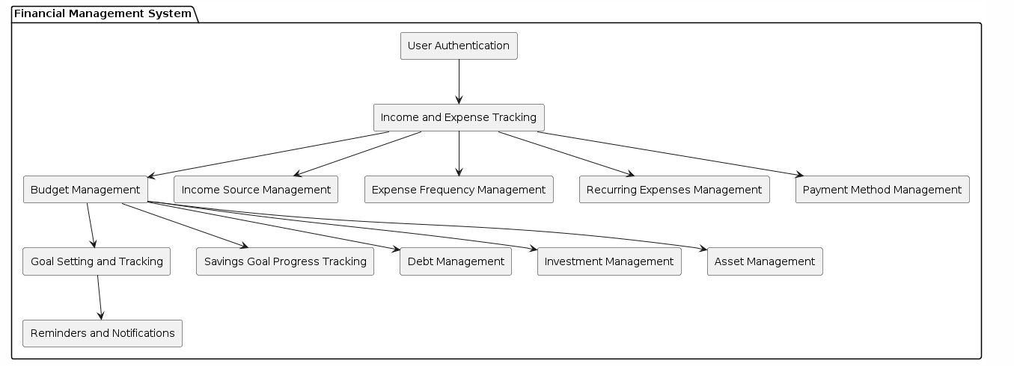
Methodology
BLOCK
DIAGRAM

Slide 9
Technologies
SQL
SQL SERVER MANAGEMENT STUDIO
C#
VISUAL STUDIO
Guna Ui Framework

Slide 10
Project Scope
The scope of the Finance Management System project encompasses the development of a comprehensive software application aimed at assisting individuals and organizations in managing their finances effectively. The project will involve the creation of a relational database model with tables including User, Transaction, Category, Budget, Goal, Notification, Income Source, Expense Frequency, Recurring Expenses, Payment Method, Income Schedule, Savings Goal Progress, Debt, Investment, and Asset.

Slide 11

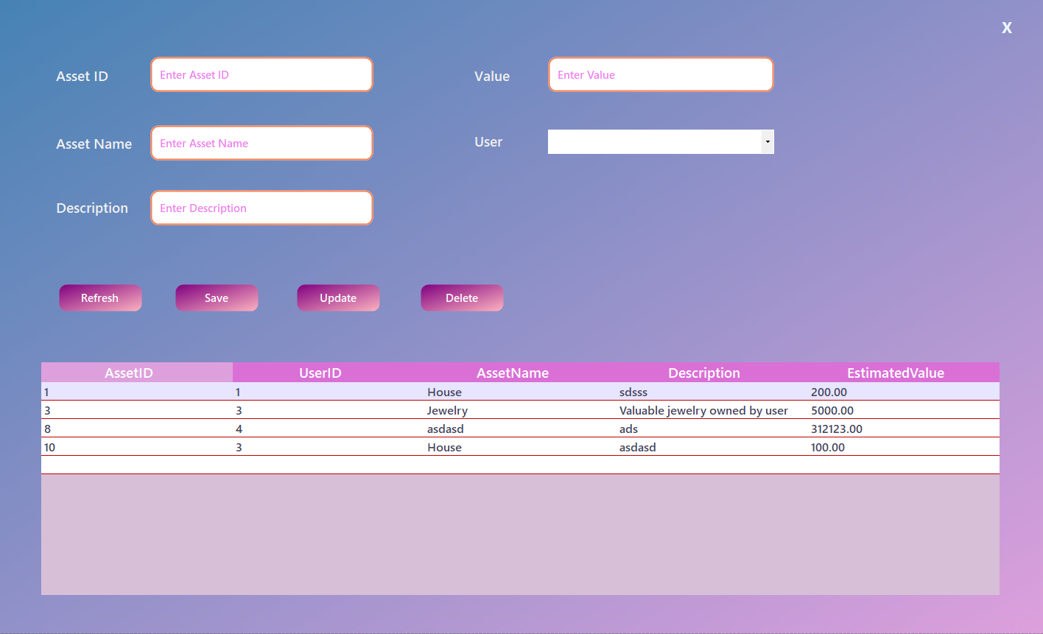
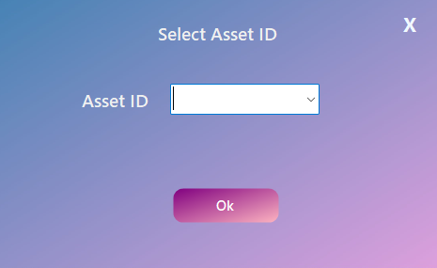
Working Software Demo
Home Page
Data Entry Page
Delete Request Box

Slide 12
References
https://www.sap.com/mena/products/erp/s4hana/what-is-financial-management-system.html
https://www.oracle.com/pk/erp/financials/what-is-financial-management-system/

Slide 13
Thank You!

